Slide 1
Northeastern University College of Engineering Department of Electrical and Computer Engineering EECE 2560: Fundamentals of Engineering Algorithms Fall 2024
Project: Real Time Emergency Response System
Name: Tyler Myers & Alex Hunt

Slide 2

Introduction
The purpose of this project is to develop a program to dispatch emergency services to various locations on Northeastern University's campus based on the urgency of the situation, route, terrain, and distance.
Notes:
Alex
START WITH THIS – Raise your hand if you have or know someone who has called NUPD?
The main problem we are trying to solve is during this emergency situation there should be no hesitation when deciding what route to take, equipment to bring, or who to dispatch.

Slide 3
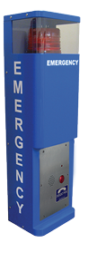
Introduction
The project's main objectives are:
To find optimal paths for emergency services based on their location on campus and the incident location.
To respond to incidents as quickly as possible by dispatching the nearest available emergency services based on the incident type.
To dynamically deploy emergency services to locations on campus that are incident hot spots.
Notes:
Tyler

Slide 4
Literature Review
Summary of Relevant Existing work Relation to Previous work

Slide 5
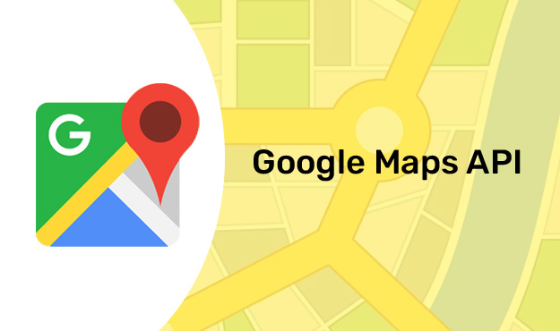
Literature Review
NUPD already has an emergency response procedure in place
Used Google API to do the routing of all personnel
Notes:
Alex
Who prefers Google maps routing compared to other applications such as apple maps or waze?

Slide 6

Literature Review
Nlohmann/json used to extract needed data from API response
Notes:
Tyler

Slide 7
Methodology
Description of Methods and Techniques Data Preprocessing Steps Pseudo Code for Techniques Time Complexity Estimation Data Structures Utilized

Slide 8
Methodology
Methods and Techniques
Data preprocessing
Parse past data from CSV
Store data about locations, emergencies, and items in arrays
Dynamic officer allocation on campus for use dispatching later
When receiving an emergency:
Get route from Google API
Algorithms to allocate officer personnel and resources.
Notes:
Alex

Slide 9
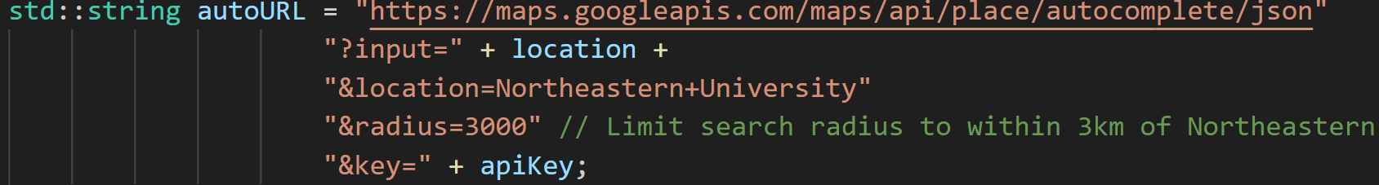
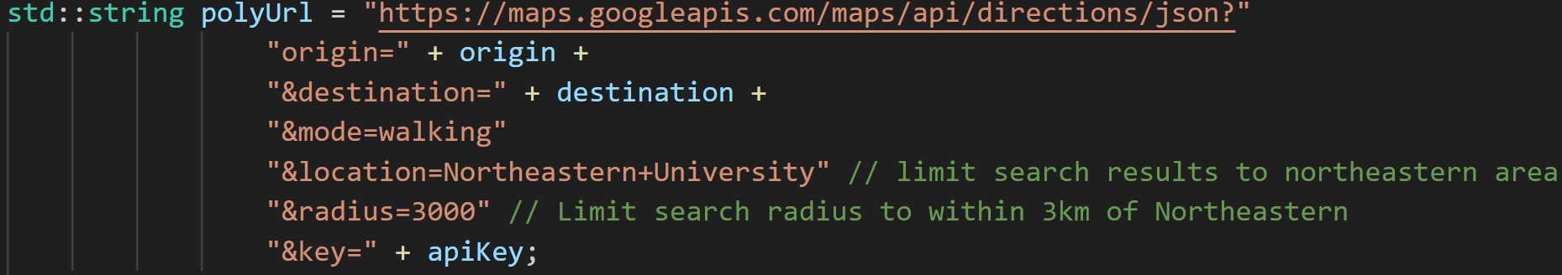
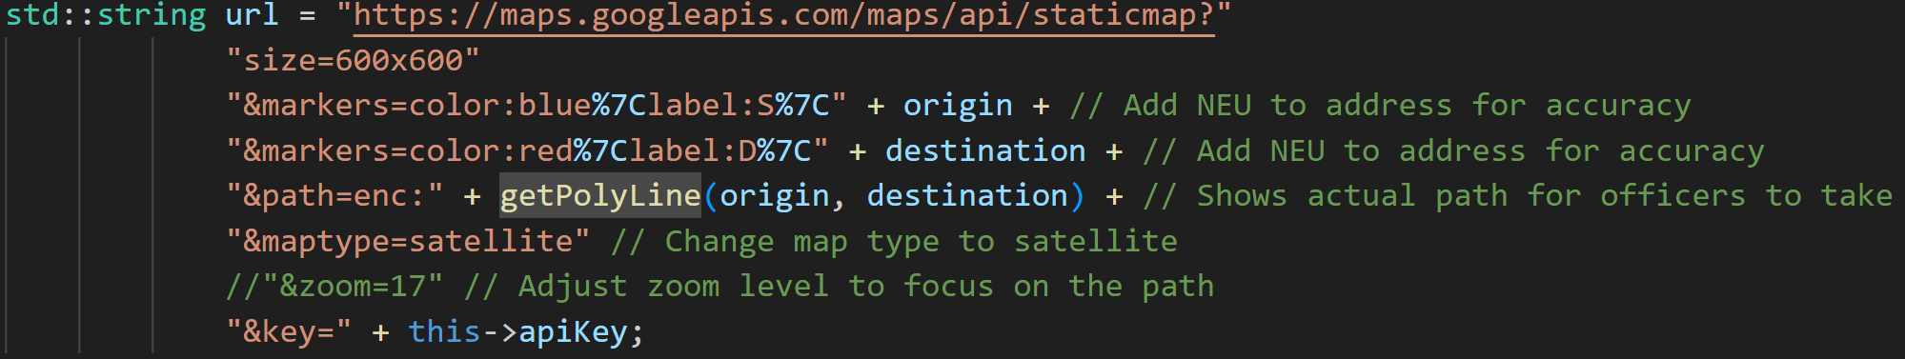
Methodology
Routing Code
Notes:
Tyler

Slide 10
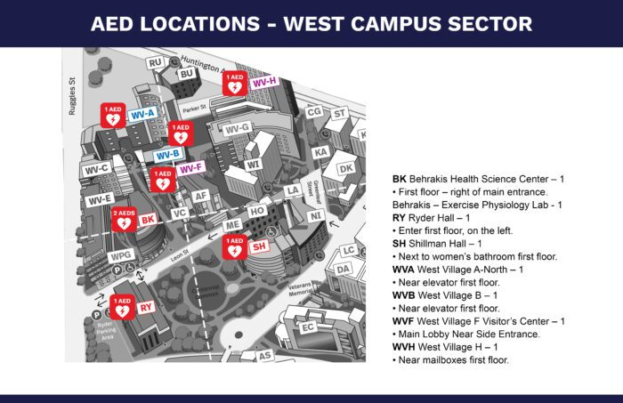
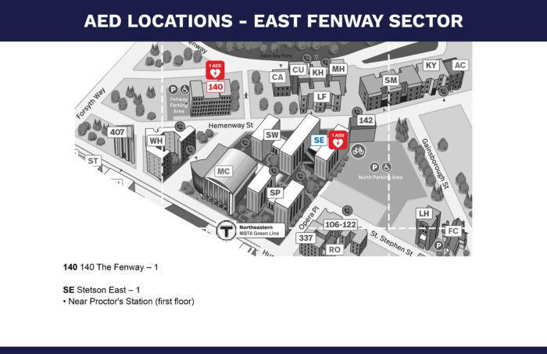
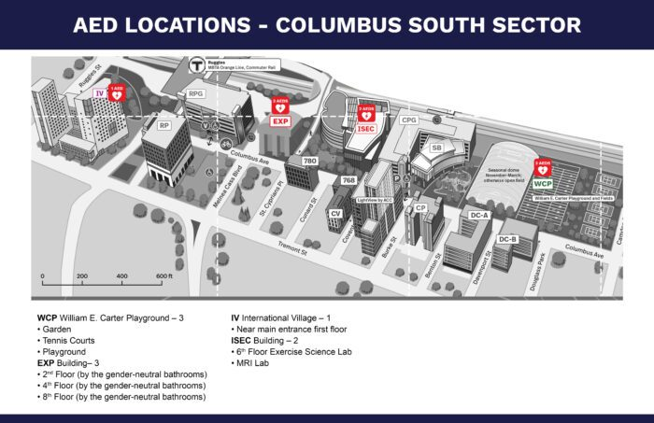
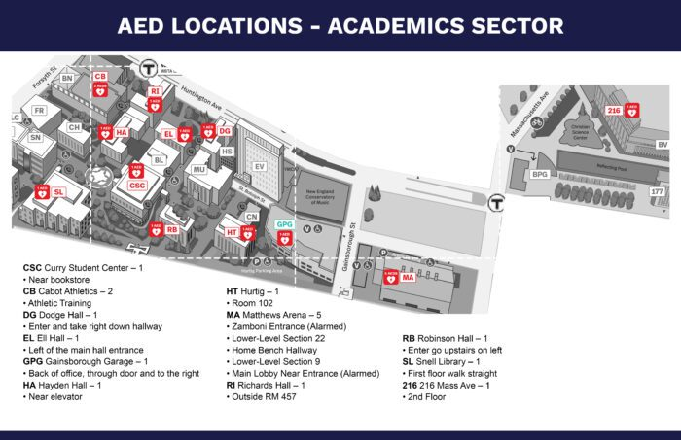
Methodology
Dynamic Allocation
PastEmergencies[0] ~ Columbus Place (Columbus South Sector)
PastEmergencies[1] ~ Behrakis (West Campus Sector)
PastEmergencies[2] ~ Curry (Academics Sector)
PastEmergencies[3] ~ Marino (East Fenway Sector)
Notes:
Tyler
Station point where officers will be (AED zone the station point is based upon)

Slide 11
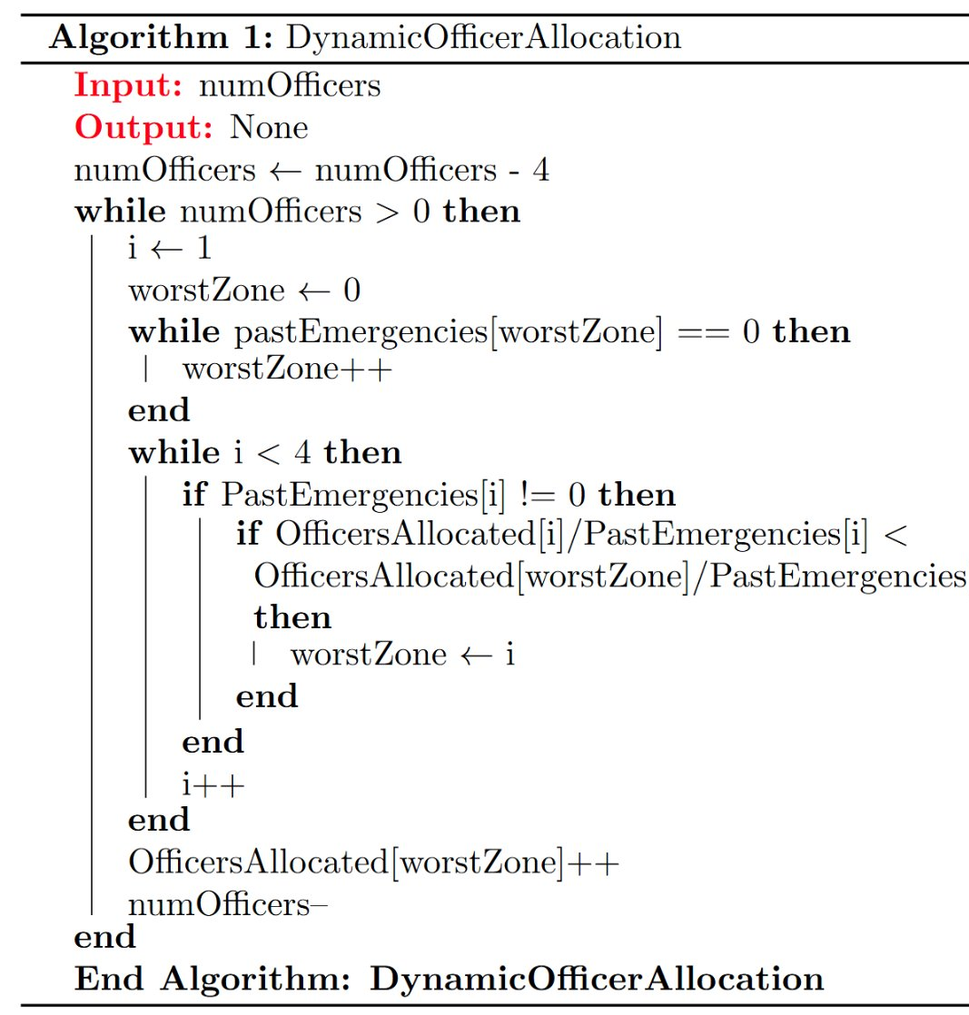
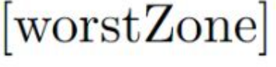
Methodology
Pseudo Code
Dynamic Allocation
Notes:
Tyler

Slide 12
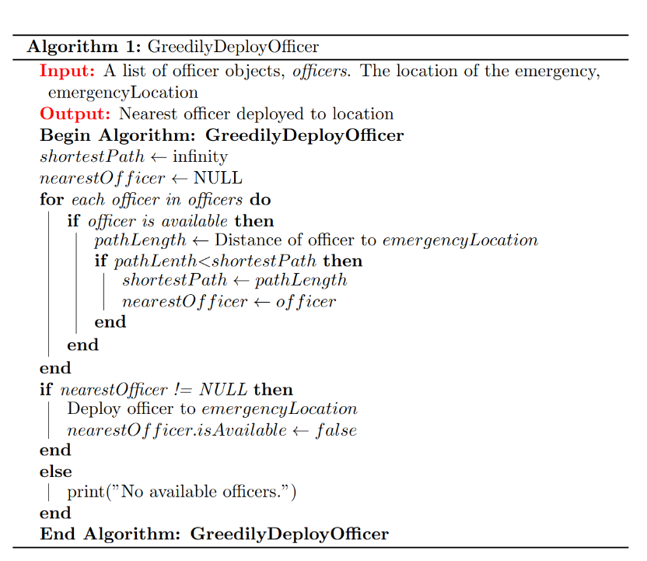
Methodology
Pseudo Code
Greedy Algorithm
Notes:
Alex
Instead of taking an officer from the zone with most officers we choose to take an officer from the closest zone. We do this to ensure best response time for each emergency

Slide 13
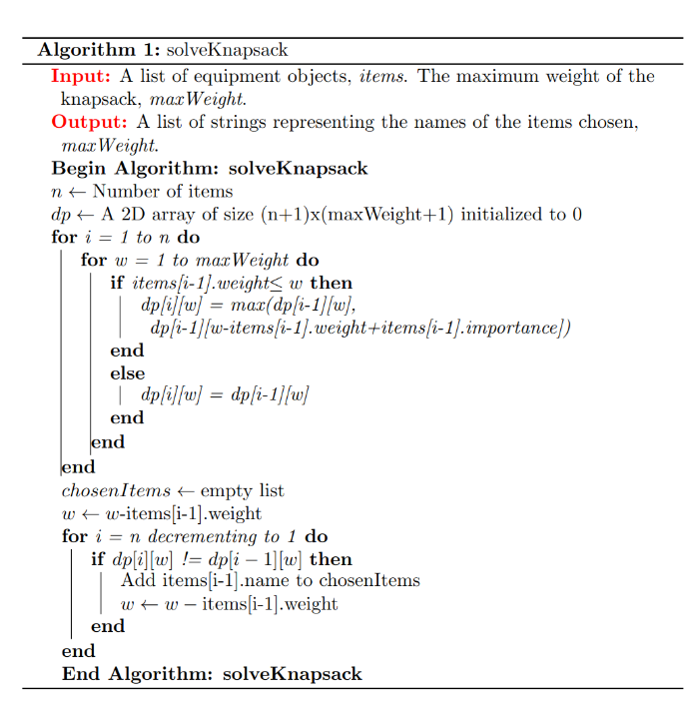
Methodology
Pseudo Code
0-1 Knapsack
Notes:
Alex

Slide 14
Methodology
Time Complexity
Dynamic Allocation O(n)
Greedy Algorith O(n)
0-1 Knapsack O(n)
Notes:
Tyler Dynamic
Alex Rest
Dynamic - outer loop iterates through every officer, but nested loops depend on the 4 zones not input size.

Slide 15
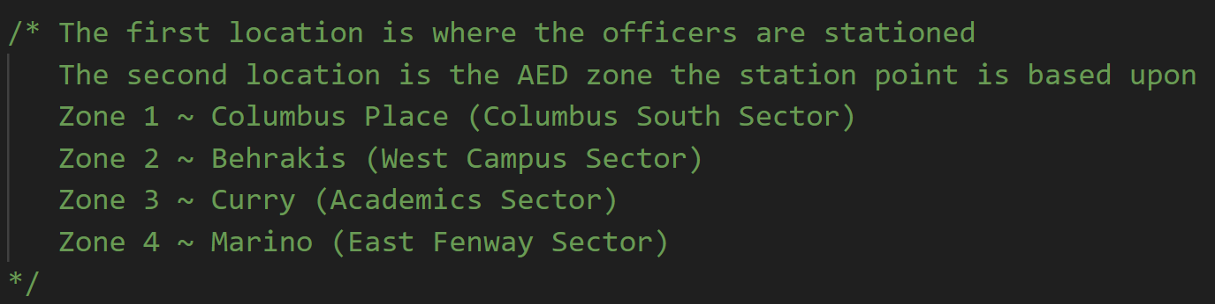
Methodology
All data stored is done so in CSV file and parsed into arrays.
Indexes correlate to the item
Equipment needed for emergency types stored in unordered map
Structs used to store officer and equipment information
Data Structures
Notes:
Tyler
Was thinking of using a map
Yet, the array has a lower time complexity and all the indexes are hard coded bc user never interacts with them
Does anyone think we should switch to maps or is there another place we could incorporate data structures in our project?

Slide 16
Analysis and Results
Presentation of Key Findings Charts, Graphs, and Tables Interpretation of Results

Slide 17
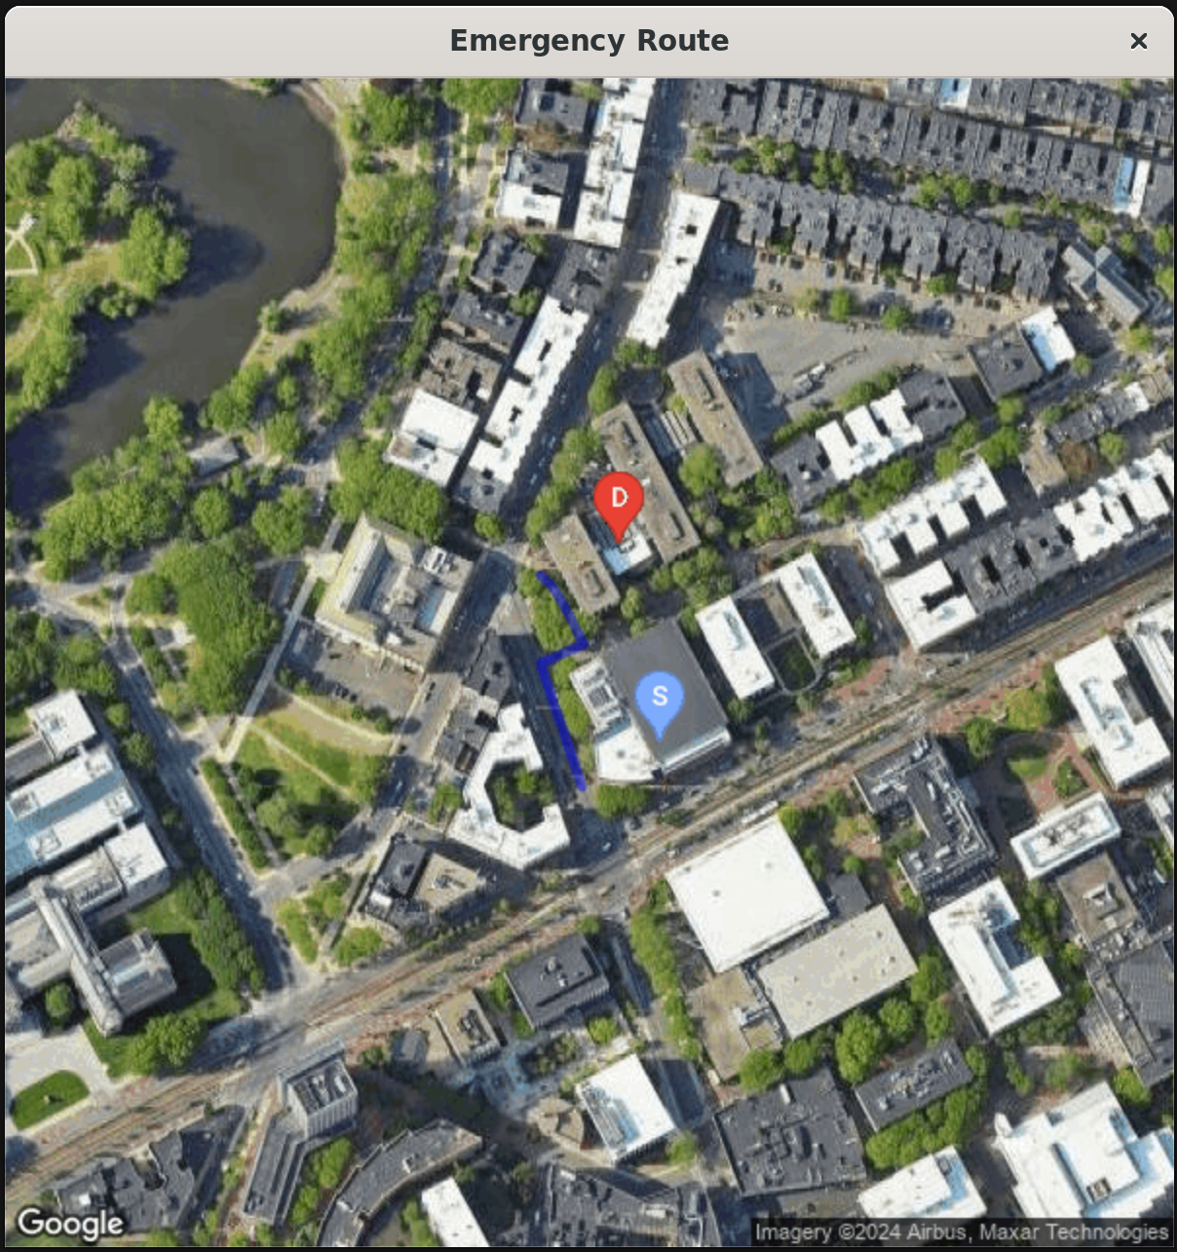
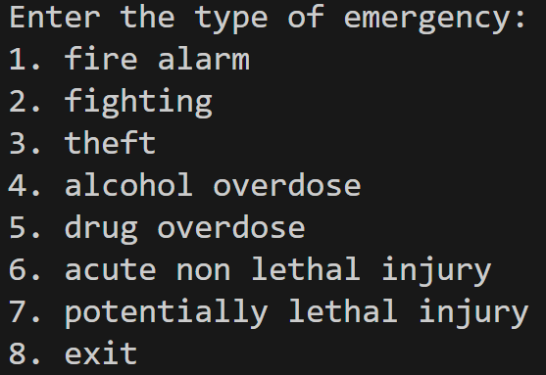
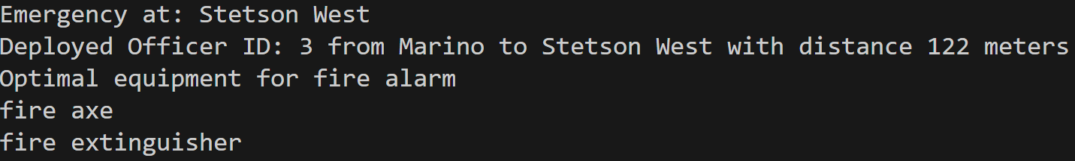
Analysis and Results
Notes:
Alex

Slide 18
Analysis and Results
Time Spent 6 hr/week * 12 weeks = 72 hours
Includes:
Drafting
Report and Presentation
Coding
Researching
Learning Google API
Notes:
Alex

Slide 19
Analysis and Results
Talk through live demonstration
Notes:
Alex

Slide 20
Discussion
Implications of Findings Study Limitations

Slide 21
Discussion
Project was limited by the deadline
Large potential for expansion, but good MVP
Notes:
Tyler

Slide 22
Conclusion
Conclusions from the Study Recommendations for Future Research

Slide 23

Conclusion
Our project is viable
Improvements:
Number of emergency types and resources available
Flush out the GUI
Notes:
Tyler
Viable, completes the primary task of handling and distributing emergencies
Solves crucial problem

Slide 24
References
https://console.cloud.google.com/apis/library

